Slide 1
Sparse Generalized Singular Value Decomposition
Vincent Guillemot, Vincent Le Goff, Ju-Chi Yu, Hervé Abdi

Slide 2
Some mental images

Slide 3
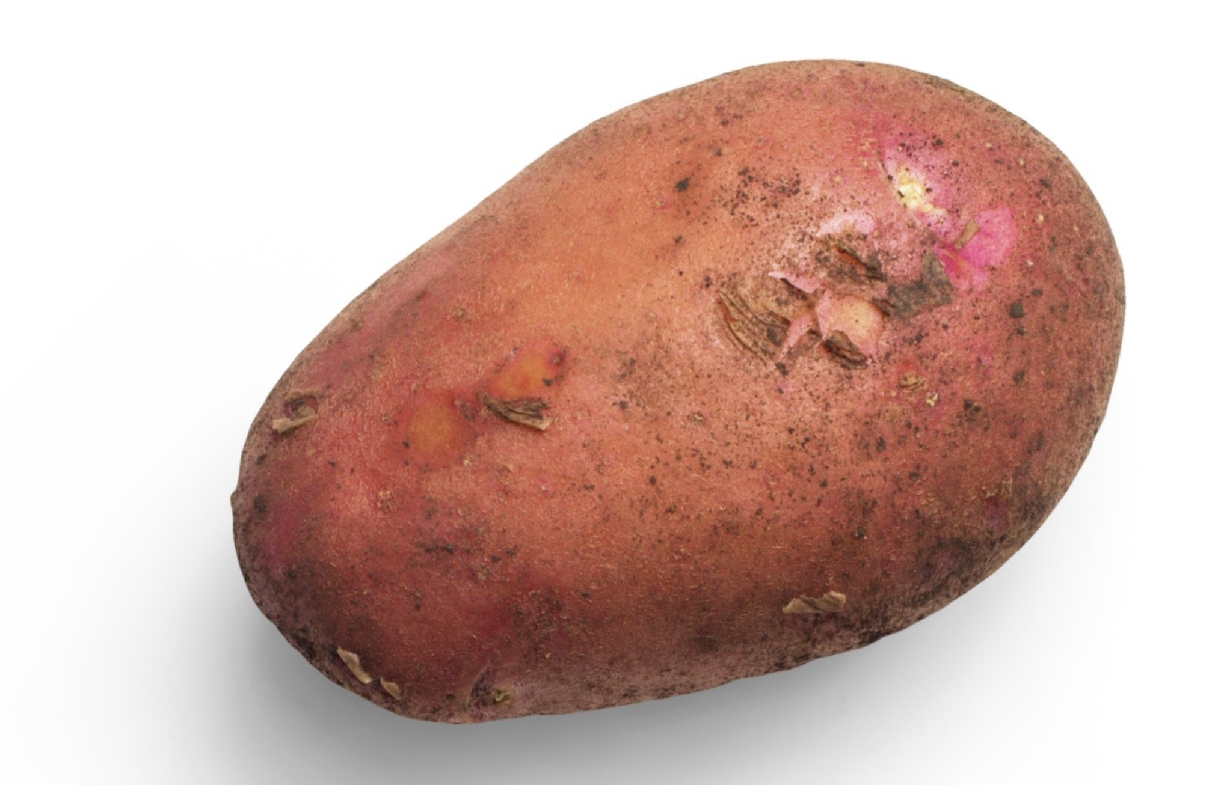
Potato Chips Analysis
Cut the yummiest French fries

Slide 4

Whale versus krill: this is you (credit: Allison Horst)
Artwork by @allison_horst https://twitter.com/allison_horst
Eat the most krill (put on your 3D glasses)

Slide 5
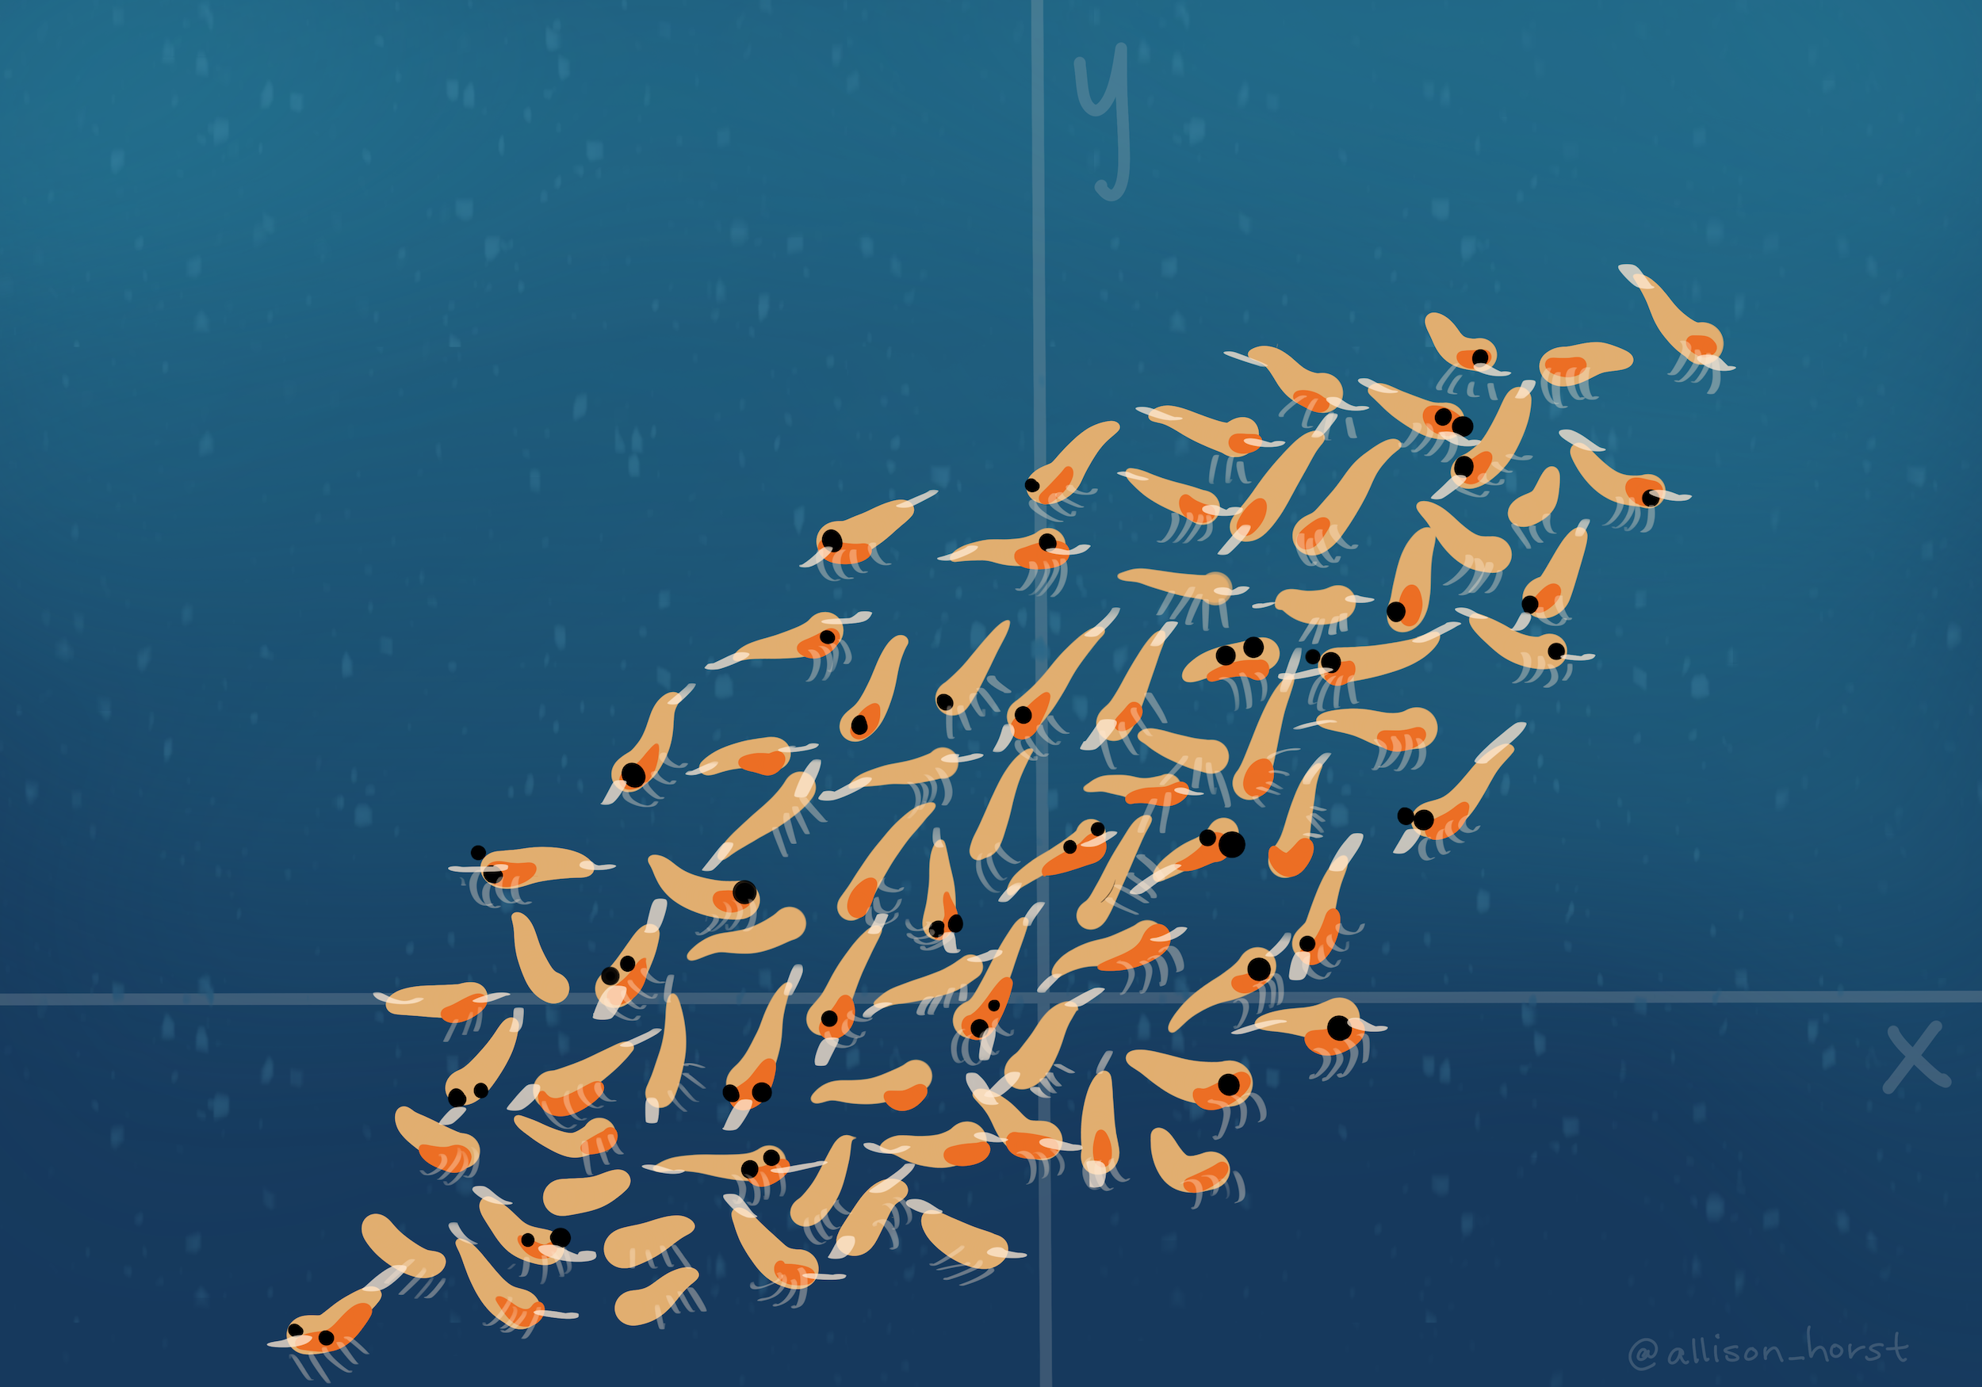
Whale versus krill: this is your data (credit: Allison Horst)
Eat the most krill (put on your 3D glasses)

Slide 6
Artwork by @allison_horst https://twitter.com/allison_horst

Slide 7
The tri-force of PCA

Slide 8
Beautiful illustration
Screeplot, versus individual map, versus circle of correlation. With the associated theoretical concepts: inertia (multivariate variance), distance between individuals, and angles between

Slide 9
Example data
xtmp <- readxl::read_excel("../data/simul.xlsx") x <- as.matrix(xtmp[, -1]) rownames(x) <- xtmp$Ind

Slide 10
Example screeplot

Slide 11
Example individual map

Slide 12
Example circle of correlation

Slide 13
Vocabulary

Slide 14
French versus English
English | French
PCA = principal component analysis | ACP = analyse en composantes principales
SVD = singular value decomposition | SVD = décomposition en valeurs singulières
EVD = eigenvalue decomposition | décomposition en éléments propres
ICA = independent component analysis | ICA = analyse en composantes indépendantes
MDS = multidimensional scaling | MDS = multidimensional scaling
“Aaaaah, mais acépé en fait c’est la pisci-aïe !”
(Anonymous student, after 6 hours of teaching PCA in French)

Slide 15
R vocabulary
Base methods:
eigen for eigenvalue decomposition, svd for singular value decomposition,
prcomp and princomp for PCA,
biplot
Nice packages:
FactoMineR: PCA, MFA, CA, MCA and associates. In earlier versions, the graphs were “crude”…
factoextra: “helper” package to make beautiful plots, and much more!
ade4: more than “one block” type of analyses. Made by ecologists so $⇒$ PCOA, coinertia analysis, STATIS, etc.
ExPosition: made for psychometricians (they like PLS)

Slide 16
And a few nice books and papers
MOOC multivariate data analysis by François Husson: https://husson.github.io/MOOC_AnaDo/index.html (FR/EN)
PCA paper(s) by Hervé Abdi: https://personal.utdallas.edu/~herve/abdi-awPCA2010.pdf

Slide 17
A little bit of Math

Slide 18
Notations
(non-universal) Conventions: matrices and vectors are bold
$I$ = number of observations, $J$ = number of variables (only quantitative)
$i$ for an individual observation, and $j$ for a single variable
$X$ = data matrix, with $n$ rows and $p$ columns, sometimes already centered, and scaled, to make our life easy
$X_{j}$ = variable $j$, and $j$th column of $X$
$w$ a set of weights

Slide 19
A little detour: matrix multiplication
Take a pen and paper (or R), and do this multiplication:
$$\left[\begin{matrix}1 & −1 \\ 0 & 1 \\ 2 & 1\end{matrix}\right]×\left[\begin{matrix}1 & 2 & 3 & 4 \\ −1 & 0 & 0 & 1\end{matrix}\right]$$
Cool video: 5 ways to see matrix multiplication

Slide 20
PCA
“Find a linear combination of the columns of the data that would capture the most information.”
In mathematical words, find
$$Xw=w_{1}X_{1}+⋯+w_{p}X_{p}$$
that maximizes… wait a minute! What are the dimensions?
$X$: $I$ rows and $J$ columns,
$w$: $J$ rows and $1$ columns,
$Xw$: $I$ rows and $1$ column.

Slide 21
The mathematical translation of the intuitions behind PCA

Slide 22
Most popular intuition of PCA: how does it translate?
“PCA creates a linear combination of variables that maximizes variance.”
$$arg\max_{∥w∥_{2}^{2}=1}\text{var}\left(Xw\right)$$
Why $∥w∥_{2}=1$?
Dirty trick: $\text{var}\left(Xw\right)=w^{⊤}X^{⊤}Xw$

Slide 23
Least “well-known” intuition of PCA: how does it translate?
“PCA creates a linear combination of variables that maximizes correlation.”
$$arg\max_{w}\sum_{j=1}^{p}{\text{cor}}{\left(Xw,X_{j}\right)}^{2}$$

Slide 24
Second least “well-known” intuition of PCA: how does it translate?
“PCA creates the best lower rank approximation of the covariance matrix.”
$$arg\min_{∥w∥_{2}^{2}=1}{∥\frac{1}{n}X^{⊤}X−λww^{⊤}∥}_{F}^{2}$$
$\frac{1}{n}X^{⊤}X$
$λ$: the [blank] of the covariance matrix
$w$: the [blank] of the covariance matrix

Slide 25
A little image

Slide 26
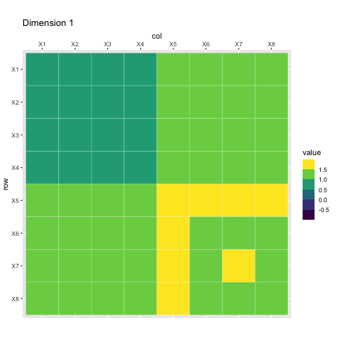
Rank-1 approximations

Slide 27
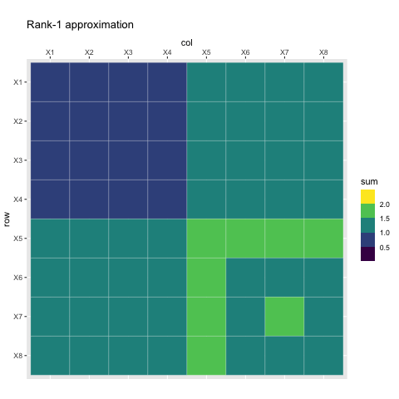
Increasing rank approximations

Slide 28
We can do the same kind of magic with the data itself
Singular value decomposition can be used to approximate a rectangular matrix with a lower ranked matrix of the same dimension.
$$arg\min_{∥u∥_{2}^{2}=∥w∥_{2}^{2}=1}{∥X−δuw^{⊤}∥}_{F}^{2}$$
$δ$: singular value
$u$: left singular vector
$w$: right singular vector

Slide 29
Rank 1 approximation

Slide 30
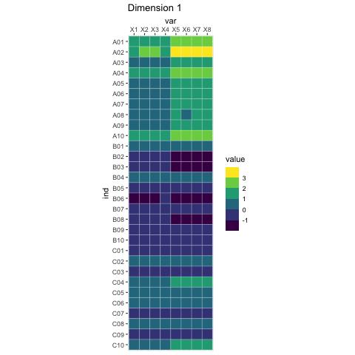
Rank-1 approximations

Slide 31
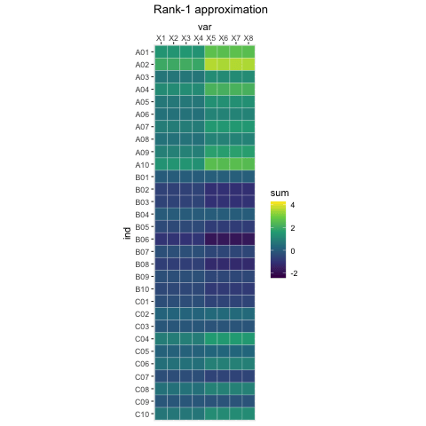
Increasing rank approximations

Slide 32
Constraining the SVD

Slide 33
LASSO
LASSO is a (relatively) recent technique originally intended for regression problems:
$$arg\min_{β}{∥y−Xβ∥}_{2}^{2}\text{ such that }∥β∥_{1}≤r$$
or the dual form
$$arg\min_{β}{∥y−Xβ∥}_{2}^{2}+λ∥β∥_{1}$$
the obtained weights are sparse (with zeros)
the non-zeros coefficients correspond to important variables
the result is biased
selecting $λ$ is done through cross-validation

Slide 34
Optimization problem
$$\begin{matrix}\left(δ_{ℓ},p_{ℓ},q_{ℓ}\right)=arg\min_{β}{∥X−δp^{⊤}q∥}_{2}^{2} \\ \text{ such that }\left\{\begin{matrix}p^{⊤}Mp=q^{⊤}Wq=1 \\ p^{⊤}Mp_{ℓ^{′}}=q^{⊤}Wq_{ℓ^{′}}=0,∀ℓ^{′}<ℓ \\ ∥p∥_{1}≤s_{p,ℓ}\text{ and }∥q∥_{1}≤s_{q,ℓ}\end{matrix}\right.\end{matrix}$$

Slide 35
What are the parameters?
$M$ and $W$ = masses, weights… so metrics
$s_{p,ℓ}$ and $s_{q,ℓ}$ = sparsity parameters, between 1 (strong sparsity), and $\sqrt{\text{dimension}}$ (no sparsity)

Slide 36
A few fun papers
We belong to the fan club of: (Witten, Tibshirani, and Hastie 2009; Trendafilov 2014, Journee2010).
Our work on:
Constrained Singular Value Decomposition (Guillemot et al. 2019)
Sparse Correspondence Analysis (Abdi et al. 2024)
Sparse Multiple Correspondence Analysis (Guillemot et al. 2020; Yu et al. 2024)

Slide 37
References
Abdi, Hervé, Vincent Guillemot, Ruiping Liu, Ndèye Niang, Gilbert Saporta, and Ju-chi Yu. 2024. “From Plain to Sparse Correspondence Analysis: a Generalized SVD Approach.” Statistica Applicata - Italian Journal of Applied Statistics 35 (3): 1–39. https://doi.org/10.26398/IJAS.0035-014.
Guillemot, Vincent, Derek Beaton, Arnaud Gloaguen, Tommy Löfstedt, Brian Levine, Nicolas Raymond, Arthur Tenenhaus, and Hervé Abdi. 2019. “A constrained singular value decomposition method that integrates sparsity and orthogonality.” Edited by Shyamal D Peddada. PLOS ONE 14 (3): e0211463. https://doi.org/10.1371/journal.pone.0211463.
Guillemot, Vincent, Julie Le Borgne, Arnaud Gloaguen, Arthur Tenenhaus, Gilbert Saporta, Sylvie Chollet, Derek Beaton, and Hervé Abdi. 2020. “Sparse Multiple Correspondence Analysis.” In 52èmes Journées de Statistique, 830–35. 52èmes Journées de Statistiques de La Société Française de Statistique (SFdS). Nice, France: Société Française de Statistique (SFdS). https://pasteur.hal.science/pasteur-03037346.
Trendafilov, Nickolay T. 2014. “From Simple Structure to Sparse Components: A Review.” Computational Statistics 29 (3-4): 431–54.
Witten, Daniela M, Robert Tibshirani, and Trevor Hastie. 2009. “A Penalized Matrix Decomposition, with Applications to Sparse Principal Components and Canonical Correlation Analysis.” Biostatistics 10 (3): 515–34.
Yu, Ju-Chi, Julie Le Borgne, Anjali Krishnan, Arnaud Gloaguen, Cheng-Ta Yang, Laura A. Rabin, Hervé Abdi, and Vincent Guillemot. 2024. “Sparse Factor Analysis for Categorical Data with the Group-Sparse Generalized Singular Value Decomposition.” Computational Statistics and Data Analysis.

